Slide 1
Self-Configuring Lighting Control System
Aakriti Yadav (2K10/EC/002)
Bhuvi Chopra (2K10/EC/045)
Dhwani Kapoor (2K10/EC/053)
Ekta Sengar (2K10/EC/056)

Slide 2
INTRODUCTION
The Self-Configuring Lighting Control System senses luminosity inside and outside a room, controls the angle of the blinds and dims the lamps to maintain a prescribed level of illumination inside the room. The system also provides the user with 4 pre-programmed ambience settings that can set the tone of the room with just a button press. It is an environmentally friendly system that saves energy by keeping unoccupied rooms unlit and maximizing the use of available natural light. In the long-run, it provides control solutions that reduce energy costs and extends lamp life.

Slide 3
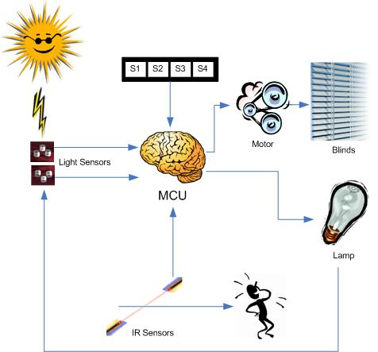

Slide 4
There are four pre-programmed settings are available.
Bright day On a bright day, one can open up all blinds letting plenty of natural sunlight in and turning off the lights to save energy.
Privacy The Privacy setting sets a medium level of illumination while closing all blinds, providing comfort and visual security to the user.
Relaxing The Relaxing setting is perfect to set a soothing ambience; combining the privacy of closed binds with low lights.
Sleep Turns off all lights and closes all blinds so that the user can rest peacefully

Slide 5
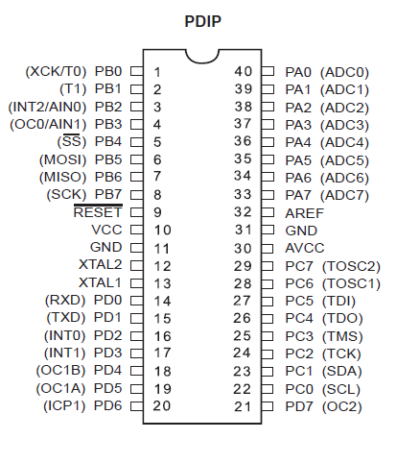
Hardware design
We have used a high performance, low power
mcu, Atmega32. It is a 8 bit microcontroller based
on RISC architecture.

Slide 6
Software
We will use Codevision AVR and AVR studio for programming and debugging.
Proteus ISIS professional will be used for simulation of the design.

Slide 7
Occupancy Detector
An occupancy detector circuit is built using a pair of infrared transceivers. For Receiver LTR-4206E was used and for Transmitter: LTE-4208. When an opaque object is put in between the aligned transceiver current flows through the receiver.
Putting one transceiver on a door can be used to determine whether someone crossed the door, however, two are needed to determine the direction of the person crossing the door.
The voltage that develops across the receiver is dependent on the opaqueness of the object and the distance between the transmitter and receiver. To deal with this, two inverting Schmitt Triggers is designed using a LMC7111 Operational Amplifier.

Slide 8
when a person walks into the room through a door with the sensors, Sensor A is toggled first followed by Sensor B
The number of people in the room will only be increased if the sensors are toggled in the following specific order:
1.Sensor A
2.Sensor A and Sensor B
3.Sensor B
In an analogous manner, the number of people will only be decreased if the following sensors are toggled in order:
1. Sensor B
2 .Sensor B and Sensor A
3. Sensor A

Slide 9
CODE SNIPPET
if (sensorA && !sensorB)
{ if((traffic == NONE)||(traffic == IN_M)) traffic = IN; } else if (!sensorA && sensorB) { if((traffic == NONE)||(traffic == OUT_M)) traffic = OUT; } else if (sensorA && sensorB) { if(traffic == IN) traffic = IN_M; else if (traffic == OUT) traffic = OUT_M; } else if (!sensorA && !sensorB) { if(traffic == OUT_M) { if(num_people != 0) num_people--; PORTB = ~num_people; } else if(traffic == IN_M) { num_people++; PORTB = ~num_people; } traffic = NONE; }

Slide 10
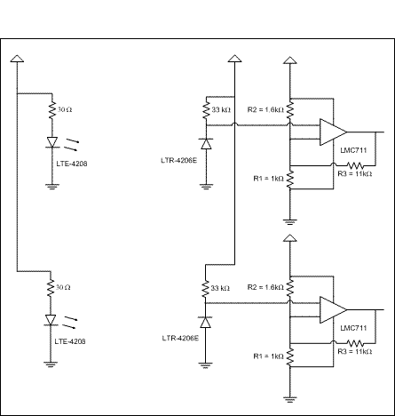
IR Sensors Schmitt Triggers
Infrared Occupancy Detector Circuit

Slide 11
Pushbutton Operation
When the button is not pressed (open switch), the port on the MCU is connected to Vcc through a 1KΩ resistor. Assuming infinite input impedance, the MCU will also going to be tied to Vcc. When the pushbutton is depressed (short circuit), the MCU will be connected to ground, toggling the port.
The controller can be fully programmed with only eight pushbuttons. The first four buttons S1-S4 are pre-set ambiances that can be recovered by pressing the buttons once.
One pressing of the Float button makes the controller enter the automatic operation mode, which is explained in more detailed in the automatic operation section. When in Float mode, the buttons Plus/Minus can be used to increase or decrease the floating value.

Slide 12
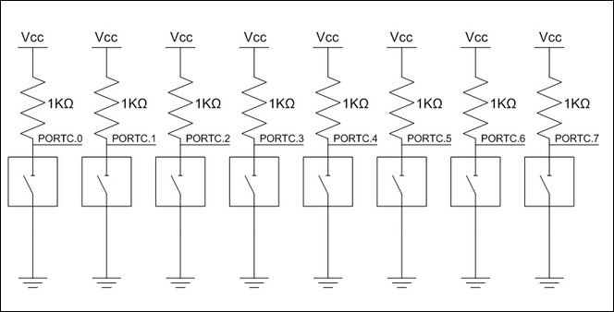

Slide 13
Button Number | Single Press | Press and hold for two seconds | Hold ‘manual ‘ button and
1 | Setting 1( bright day) | Save current conditions as Setting 1 | Open (one step) blinds
 | Setting 2( privacy) | Save current conditions as Setting 2 | Close (one step) blinds
3 | Setting 3( Relax) | Save current conditions as Setting 3 | Brighten (one step) lights
4 | Setting 4( sleep) | Save current conditions as Setting 4 | Dim (one step) lights
5 | Enter float mode
6 | Increase Illumination
7 | Decrease Illumination

Slide 14
Automatic Operation
When set to the automatic operation mode, the sensor will take full control over the blinds and the light dimmer in order to maintain a constant amount of light in the room, which is pre-determined by the user. This pre-determined light amount, called "floating value" can be increased or decreased at any time by pressing the "plus" or "minus" buttons on the controller. The coordination of the movements of the blinds and the dimming of the lamp is done prioritizing energy savings.
The automatic operation also enters the privacy mode closing the blinds when it sees that the light indoors is greater than outside and the light outside does not contribute to the illumination of the room.

Slide 15
Blinds Control
To control the angles of the blind, one unipolar stepper motors (PF35T-48L4) is used.
To provide sufficient power and torque to these motors the ULN2003AN (High-voltage, high-current Darlington transistor arrays) which provides the current necessary to drive the motors is used.
The Darlington transistor is a compound structure consisting of two bipolar transistors (either integrated or separated devices) connected in such a way that the current amplified by the first transistor is amplified further by the second one.

Slide 16
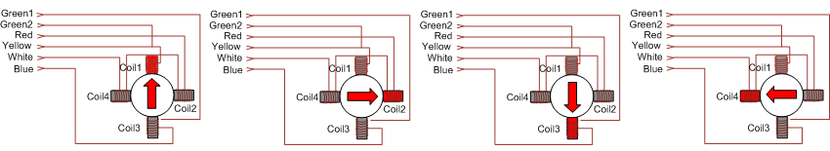
The advantage of using a stepper motor is that the angular position of the motor shaft can be controlled without any feedback mechanism. Stepper motors work on the principle of electromagnetism. There is a soft iron or magnetic rotor shaft surrounded by the electromagnetic stators. The rotor and stator have poles which may be teethed or not depending upon the type of stepper. When the stators are energized the rotor moves to align itself along with the stator (in case of a permanent magnet type stepper) or moves to have a minimum gap with the stator (in case of a variable reluctance stepper). This way the stators are energized in a sequence to rotate the stepper motor. The stepper motor’s electrical input consists of six wires; four for control and two for power supply. In order to drive the motor, a particular sequence of high/low voltages is required to be applied to the four control wires.

Slide 17
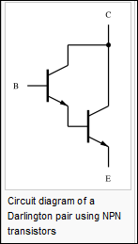
Darlington Array:
An ULN2003A is a high-voltage, high-current Darlington transistor array. It consists of seven NPN Darlington pairs that feature high-voltage outputs
The Darlington transistor (often called a Darlington pair) is a compound structure consisting of two bipolar transistors (either integrated or separated devices) connected in such a way that the current amplified by the first transistor is amplified further by the second one. This configuration gives a much higher common/emitter current gain than each transistor taken separately and, in the case of integrated devices, can take less space than two individual transistors because they can use a shared collector. Integrated Darlington pairs come packaged singly in transistor-like packages or as an array devices (usually eight) in an integrated circuit.

Slide 18
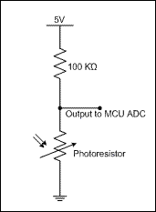
Light Sensors
To measure the intensity of light inside and outside the “house”, a pair of photo resistors (CL905L) is used. This light dependent resistor is an electronic component whose resistance decreases with increasing incident light intensity and vice-versa. This module is connected with another resistor is series. The output is connected with the Analog-to-Digital Converter input of the microcontroller to acquire the various
voltage levels.

Slide 19
ADC
ADC converts a continuous signal to a digital signal. It maps a range of values to a single level.
Number of levels in the ADC is decided by the number of bits used.
If L is the number of levels, then L = 2^n, where n is the number of bits.
Most modern MCUs have ADC on chip.
Atmega32 has microcontroller has a built in ADC with 8 input channels. These input channels are multiplexed with PORT A. It can be used in single conversion or free running mode.

Slide 20
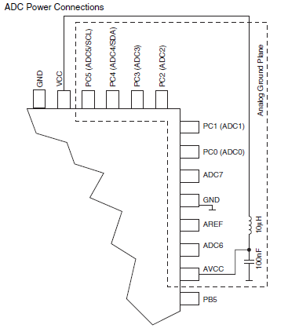

Slide 21
ADC registers
ADC has 4 registers.
ADMUX – ADC multiplexer selection register. It is used to select the reference voltage(Aref) and the input channel.
ADCSRA – ADC Status and Control register.
ADCL and ADCH – ADC data registers. The 10 bit result of ADC is presented in these registers.
The output of LDR, the light sensor, is connected to one of the
input channels of ADC.

Slide 22
INITIALIZATION
ADMUX
The reference voltage is set to Vcc by appropriately setting the values of bits 6 and 7.
ADCSRA:

Slide 23
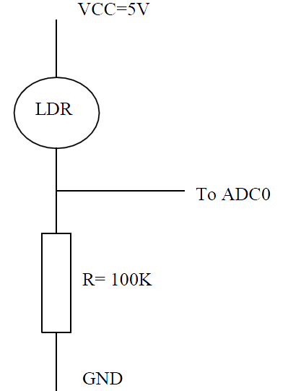
Sample code
ADMUX = 0b11100000;
//ADCSR:
//Bit7: ADC enable
//Bit6: ADC start conversion
//Bit4: ADC interrupt flag
//Bit3: ADC interrupt enable
//Bits2-0: frequency division factor (128)
ADCSR = 0b11000111;
light_out = ADCH;

Slide 24
Dimmer
Dimming can be achieved in different ways, the most straightforward being a variable resistance that varies the voltage coming in to the lamp. However, variable resistance dimming is very inefficient in terms of energy, as the resistance is turning energy into heat that is not used. An efficient way to dim an incandescent light bulb on AC power is to periodically turn off the AC sinusoid and thus provide only a fraction of the full wave to the light. So therefore we use pwm.
Pulse Width Modulation: PWM is a way of digitally encoding analog signal levels. Through the use of high-resolution counters, the duty cycle of a square wave is modulated to encode a specific analog signal level.
Duty Cycle = on time/(on time + off time)
The on-time is the time during which the DC supply is applied to the load, and the off-time is the period during which that supply is switched off. Given a sufficient bandwidth, any analog value can be encoded with PWM.

Slide 25

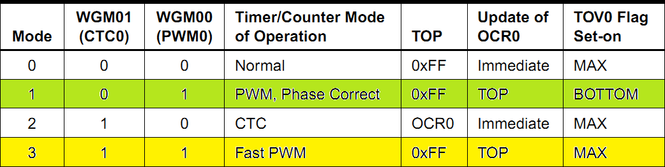
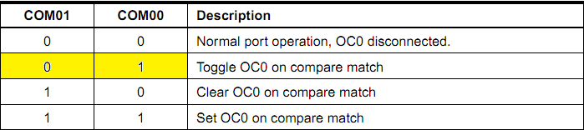
Timer Registers:
Timer/Counter Control Register-TCCR0
Bit 6, 3 – WGM01:0: Waveform Generation Mode
2. Bit 5:4 – COM01:0: Compare Match Output Mode

Slide 26
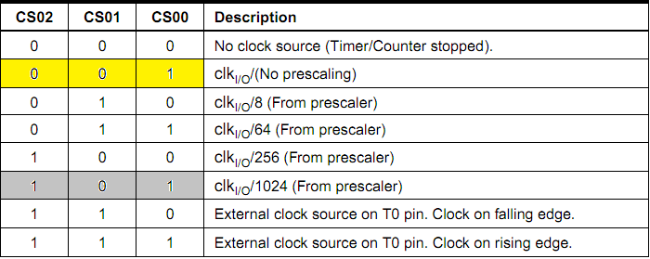
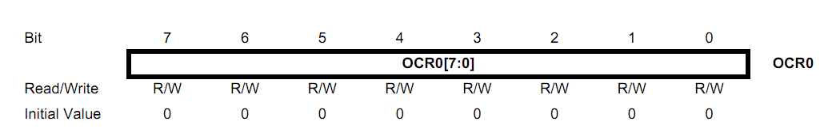
3. Bit 2:0 – CS02:0: Clock Select
Output Compare Register-OCR0
The Output Compare Register contains an 8-bit value that is continuously compared with the counter value (TCNT0). A match can be used to generate an output compare interrupt, or to generate a waveform output on the OC0 pin.

Slide 27
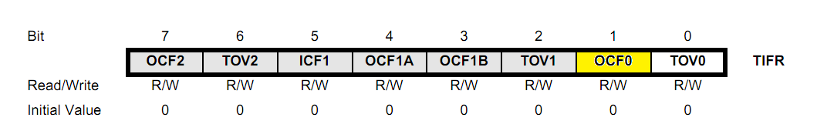
Timer/Counter Interrupt Flag Register– TIFR
Bit 1 – OCF0: Output Compare Flag 0
Sample Code:
//Bit 6 & 3: Fast PWM Mode.
//Bit 5 &4: Toggle OCO on Compare Match.
//Bit 0,1,2: Clock for Timer
TCCR0|=(1<<WGM01)|(1<<WGM00)|(1<<COM01)|(1<<CS00);
OCR0 = 128;

Slide 28
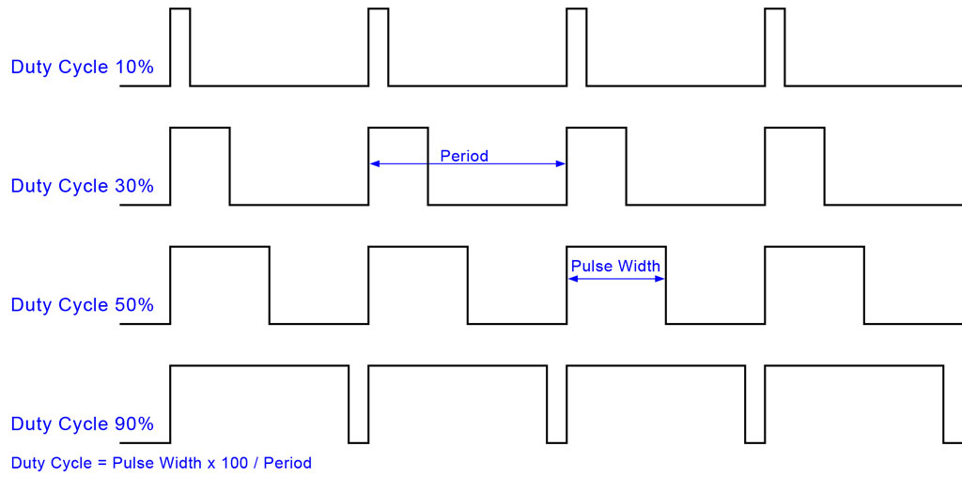
Output:

Slide 29
CONCLUSION
Self-Configuring Light Control system is a smart system that saves energy by controlling the illumination of a space. By operating on a feedback loop where the system senses light and the presence of people, the system makes smart decisions on how to best illuminate the space given the user's preference. Given that the system already has control over the lighting and the shading of the space, ambiences can be saved and recalled with ease. The light control system is very expandable and versatile. The heart of the system is an Atmel, MEGA32 8-bit microcontroller. The sensors on the system are made from easily obtained components and the control algorithms are extensive and robust.

